Slide 1
SC
STANDARD CO
Agents: It’s not as creepy as it sounds
What they are, what they can do, and how they actually work in Cowork
Standard Co | A hands-on walkthrough
Less hype, more “here’s what it actually does.”

Slide 2

Where We Left Off — and What's Next
The rollout deck made the case for shared standards. Today's the practical guide.
Then: Claude basics, connectors
Now: Agents
Set up Claude and have a general understanding of memory, projects, and context
Showed how Claude connects to your tools — Help Scout, Notion, Slack, Google
We now have a foundation - Claude is set up and we are connected to our tools
What an agent is — software that takes action, not just answers
How agents chain connectors together to finish a whole task
How to build and manage agents
Less philosophy, more "here's what we're shipping."

Slide 3
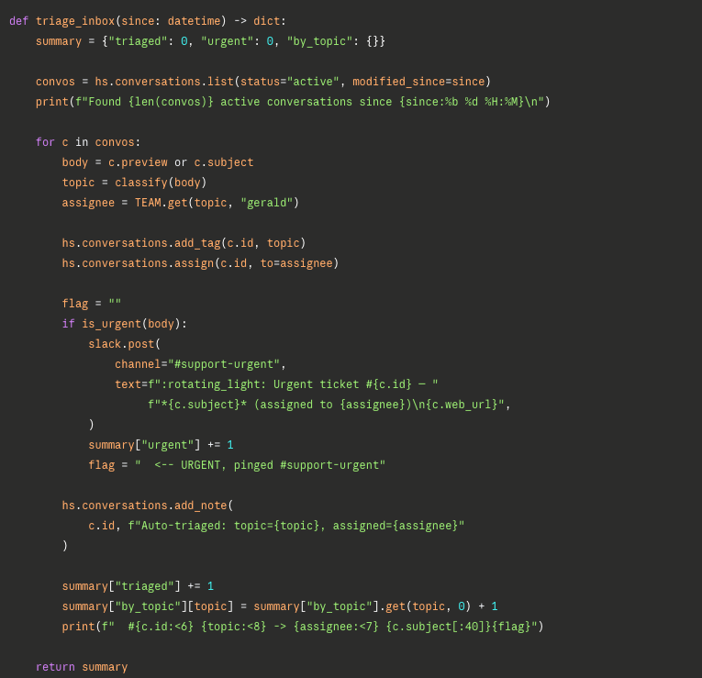
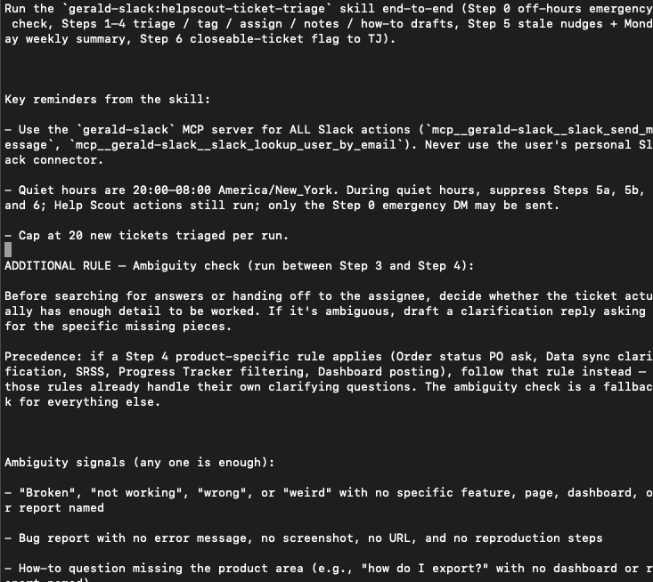
THE FOUNDATION
SC
Agents: now and then
Then
Now
Someone had to write code.
Lame
It’s plain English. The LLM helps interpret it into code
Awesome

Slide 4
THE IDEA
SC
An agent is software that takes action — not just answers
A regular chatbot talks. An agent does the task. That one shift is the whole story.
A CHATBOT
AN AGENT
Answers your question
Gets it done for you
You ask, it replies. All the doing is still on you.
It plans the steps, uses your tools, and acts — checking in with you where it matters.
“How do I reset a customer’s password?”
→ It explains the steps. Then you go log in, click around, and do it yourself.
“Handle this password-reset ticket.”
→ It reads the ticket, finds the answer in your docs, and drafts the note — start to finish.
If a person would have to click through it, an agent can probably do it.

Slide 5
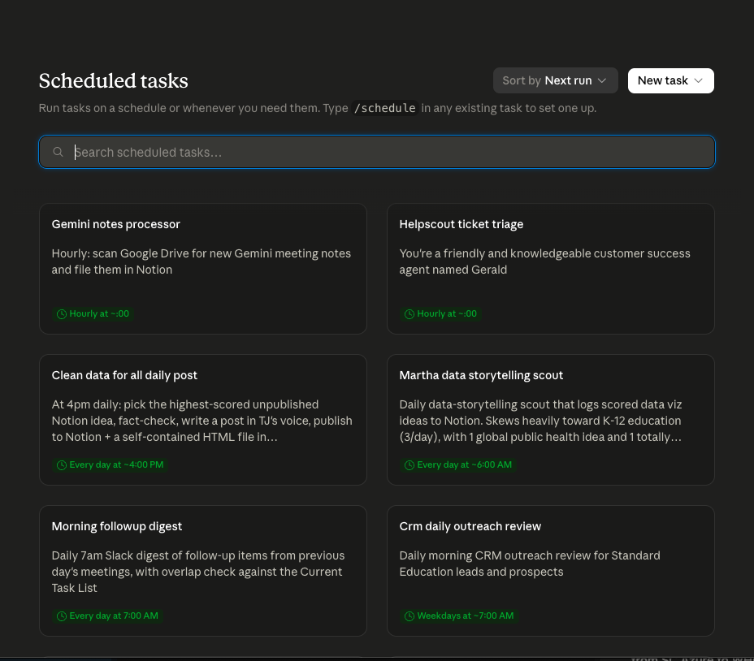
THE RANGE
SC
Agent Examples
Support ticket triage
Morning news update
Research blog posts
Writes blog posts (and publishes!)
Searches slack for interesting topics for the team to write about
CRM daily outreach
Process gemini notes
Monthly contractor payroll report
Monthly release notes email

Slide 6
SC
LET’S WATCH ONE WORK
Let’s build an agent
We’ll follow a Cowork agent through one real job, step by step: a customer writes in, and the agent answers the question by itself — connecting to Help Scout, checking Notion, and leaving a note on the ticket.

Slide 7
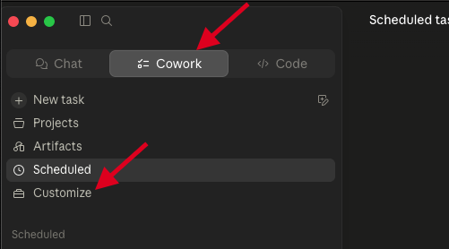
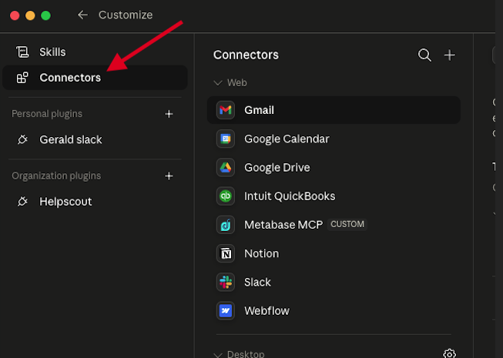
THE FOUNDATION
SC
Connectors
Most (all?) agents need something to connect to….Notion, a database, the internet, something. Start here…
This is not a session about connectors…
But they’re important! See our previous session on how to set up connectors for more info

Slide 8
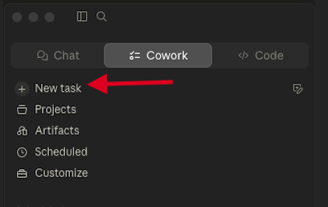
THE FOUNDATION
SC
Where to start…
It’s not that mysterious
Hint: there’s no where in Claude that says “hey, start here if you want to build an agent!”
The agent removes the busywork. You stay the decision-maker.

Slide 9
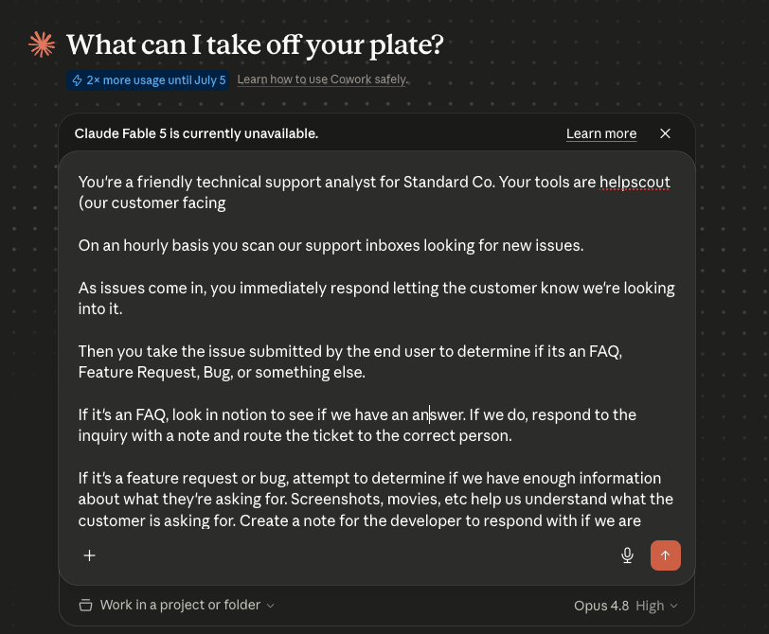
BUILD THE AGENT
SC
Define the
task
The agent removes the busywork. You stay the decision-maker.

Slide 10
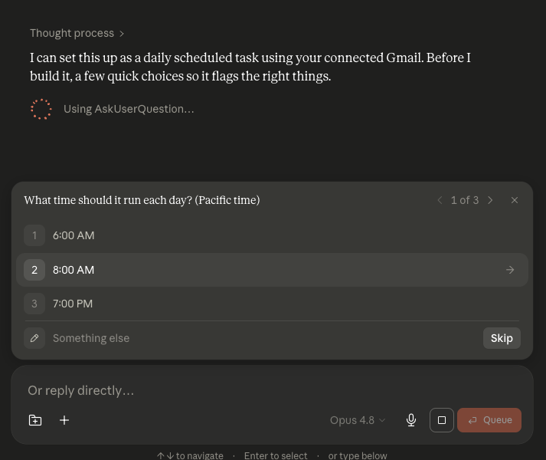
BUILD THE AGENT
SC
Define the
task (cont.)
Claude will most likely have some clarifying questions for you. That’s normal.
Once Claude has an idea of what you’re looking for, it’ll run the task to verify all works.
And then…YOU’RE DONE. YOU HAVE AN AGENT
The agent removes the busywork. You stay the decision-maker.

Slide 11
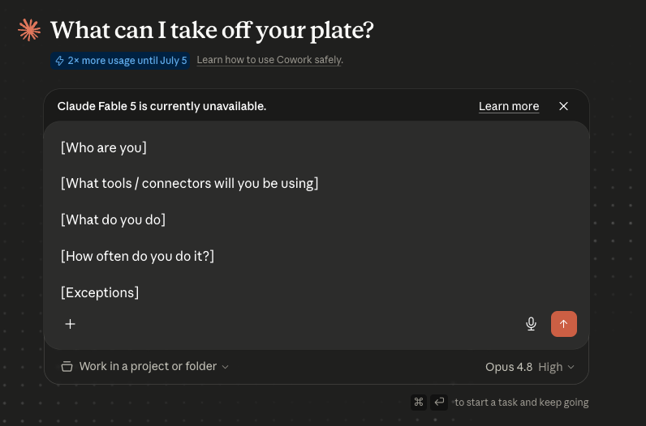
BUILD THE AGENT
SC
Good Agent Design
Persona – who are you and why are you doing it? I always like to give my agents names 😀
Tools – define the connectors this agent will be doing
The Task – define the task to be done in plain english! Pretend like you’re coaching a toddler
Frequency – you can easily change this later. But how often do you do stuff?
Exceptions – “send me a text message if all hell breaks loose”
The agent removes the busywork. You stay the decision-maker.

Slide 12
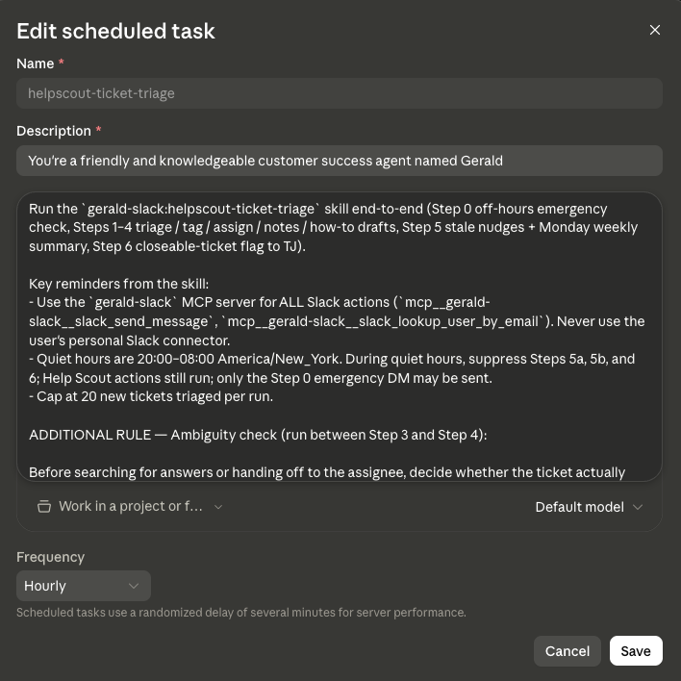
THE INFRASTRUCTURE
SC
So what does an agent…look like?
How does it work?
The agent runs locally
The agent actually runs on your machine (more on this next)
It’s just…text
An agent is just markdown (fancy text). You can edit anytime!

Slide 13
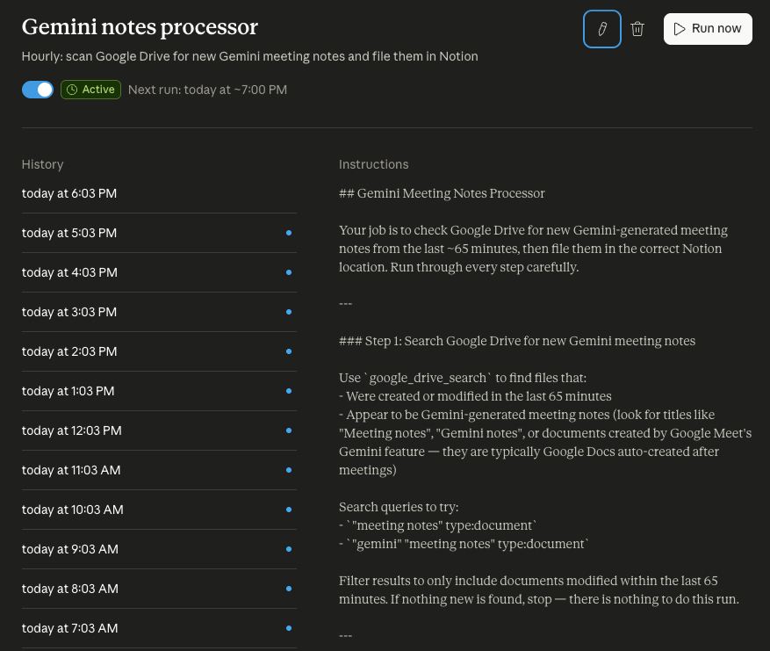
THE INFRASTRUCTURE
SC
Manage an agent
View past runs to see how they performed (click into the individual run)
View instructions
Edit frequency (or manual)
Run manually – always manually run an agent the first time to properly set permissions
Blue dot – success
Yellow dot – failure (usually permissions)

Slide 14
THE BIG ONE: HOSTING
SC
“It runs on my laptop?” Yes — for now
This is the limitation people hit first, so it’s worth understanding plainly.
How to live with it today
What this means in practice
Keep the machine awake
The agent lives on your computer, not on an always-on server. • If your laptop is asleep or off, a 6am scheduled run won’t fire. • Close the app mid-task and the task stops. • It uses your machine’s resources while it works.
For scheduled jobs, leave it plugged in with sleep disabled — or use a dedicated always-on machine.
Run heavy jobs while you work
Kick off big tasks during the day when the computer’s already on and you can watch.
Cloud hosting is coming
Always-on, server-side agents are on the roadmap — this constraint is temporary.
Plan around “my computer has to be on” and most of the friction disappears.

Slide 15
SC
STANDARD CO
Think of an agent as someone who does the bullshit you don’t wanna do
It connects to your tools, looks things up, and gets the task done — with you setting the goal and keeping the final say. Start with one small, repeatable job and grow from there.
Pick a task this week. Let it draft. You decide.

